Slide 1


Child and Adult Care Food Program (CACFP)
Sponsor Site Training

Slide 2



Janee Wilson
Child Nutrition Coordinator
Gillian McPherson
Child Nutrition Manager
Enrique Ramirez
Child Nutrition Coordinator
I'm very excited to work with the community and help combat food insecurity in Alaska
Looking forward to serving the communities in Alaska in a tangible way.
Blessed to work for an organization that provides CACFP to children in rural villages and communities throughout the state of Alaska; those that may need it the most.

Slide 3

Training Agenda
CACFP Meal Pattern-
  Components & Food Substitutions and Medical Statements
Meal service Style
Menu
Program requirements
Record Keeping Requirements
Health and sanitation
Civil Rights
Monitoring
Meal Delivery and Ordering Requirements

Slide 4
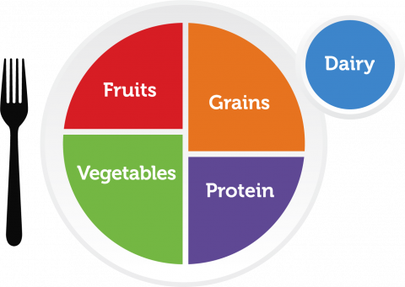
CACFP Meal Pattern Requirements
Goal: serve nutritious, appetizing meals that meet meal pattern requirements
Meal pattern requirements - balanced meals that supply food to help meet nutrient and energy needs of children
Notes:
Meal patterns establish minimum portions of meal components that must be served in order for the sponsor to receive reimbursement for each meal.

Slide 5
CACFP Meal Patterns
Breakfast Select all three food components: | Lunch or Supper Serve all five food components: | Snack Select two of the five food components:
Milk Vegetable, fruit or both Grains | Milk Meat/Meat Alternates Vegetables Fruits Grains | Milk Meat/Meat Alternate Vegetable Fruits Grains
Notes:
Only serve lunch and dinner options at this time thru FBA

Slide 6

Allergies??
Need Medical Statement
signed by DR/Medical Professional
- Food to be avoided (allergen)
- Explaining how participant is affected by the allergen
- List of recommended substitutes
Notes:
With food being pre-plated and the Nutrition content well documented it makes it easy to spot the allergens thus preventing the child from taking the wrong food
Reasonable accommodations can be made to a site's meal patten with the submission of a signed medical statement from medical provider.
FBA will review the medical statement and asses if the request is reasonable logistically.
If a site makes any substitutions or dietary accommodations to a meal served to a participate without communication to the FBA the FBA will not reimburse that meal and that meal cannot be counted on the meal count form.
The FBA is required to make reasonable accommodations for allergens sometimes it is just not realistic to change for one student. So they just need to except the product and can put it on a share table.

Slide 7

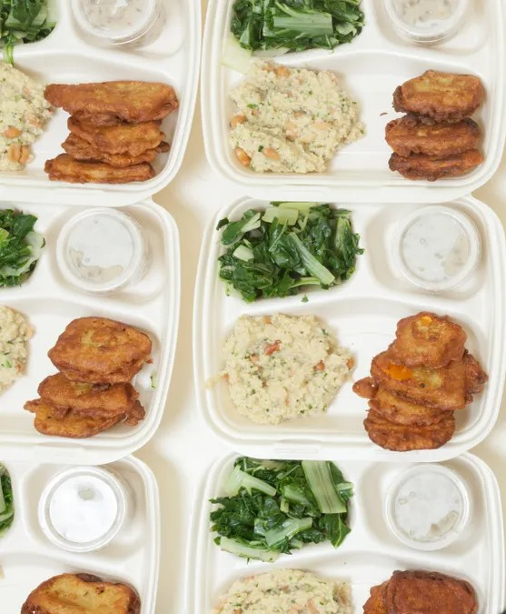
Meal Service Style
Notes:
Family Style: type of dining where there is bigger plates in the middle of the table and food is passed around and conversation is encouraged amongst the children
Pre-Plated: all the food is portioned to the exact meal pattern requirements. Sometime pre-packaged or portioned on a plate by staff

Slide 8
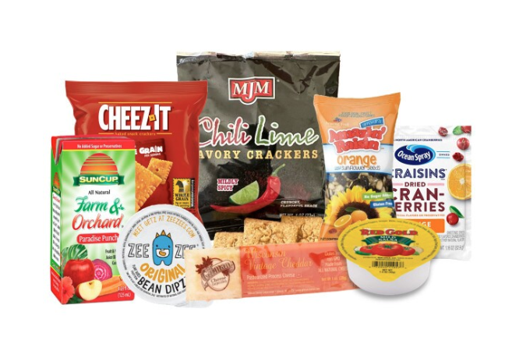
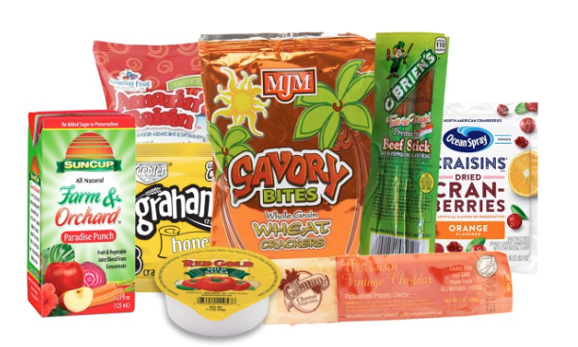
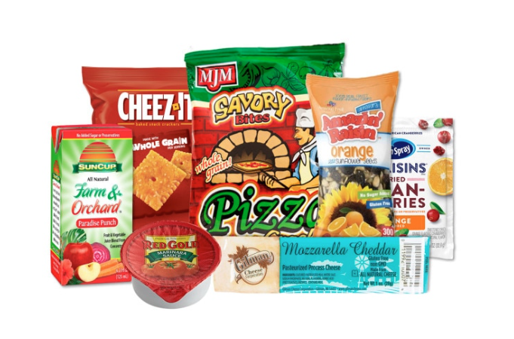
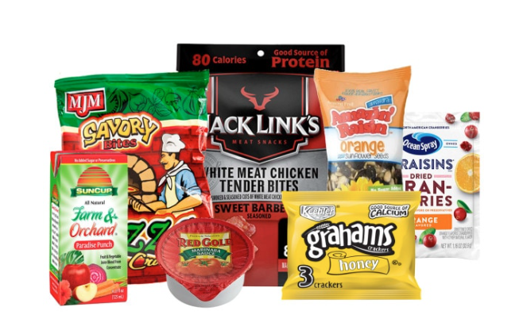
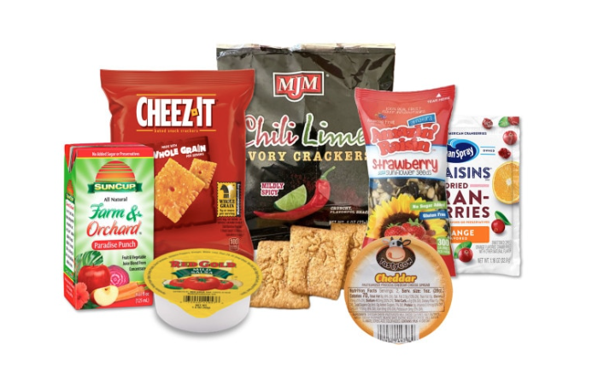
Menu
Bean Dip Meal
Meat and Cheese Meal
Pizza Meal
Wings and Pizza Meal
Nacho Meal
Notes:
Vendor Optimum foods
Has 5 different meals
With 8oz of Milk

Slide 9
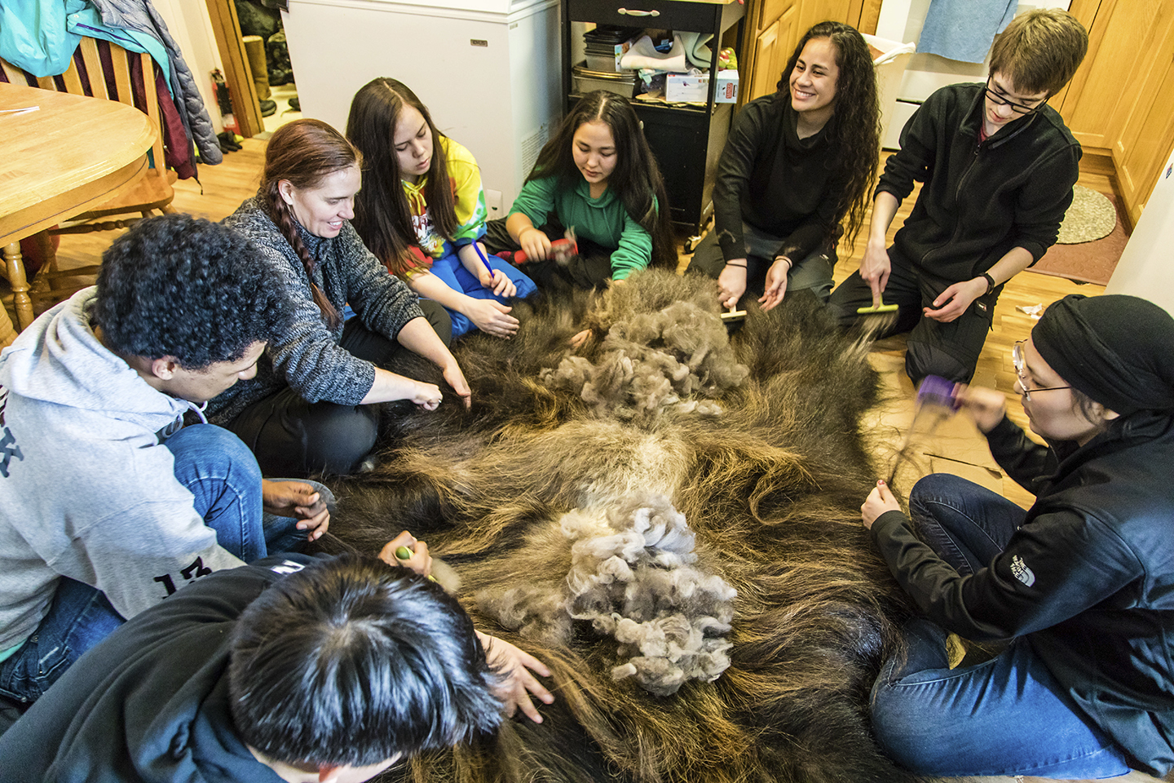

Requirements
Weekly Activity Calendar
Supervision
Safe Environment To Enjoy the Food
Notes:
Weekly calendar- need to follow weekly calendar, be around the meal service
Do not have to force the kids to participate but need to be offered

Slide 10

Record Keeping Requirements
Documents Required:
Daily Attendance
Daily Meal Counts
Weekly Menu
Monthly Inventory
Notes:
Need to fill out four different required documents 1) Attendance 2) Meal Counts 3) Weekly Menu 4) Monthly Inventory
Attendance always needs to exceed the meal count...can't hand out more meals than kids coming
Need Note about second meal??
Need to have working menu displayed same thing as the list the FBA send to site. Make any notation on the working menu if type of food/portions change.

Slide 11
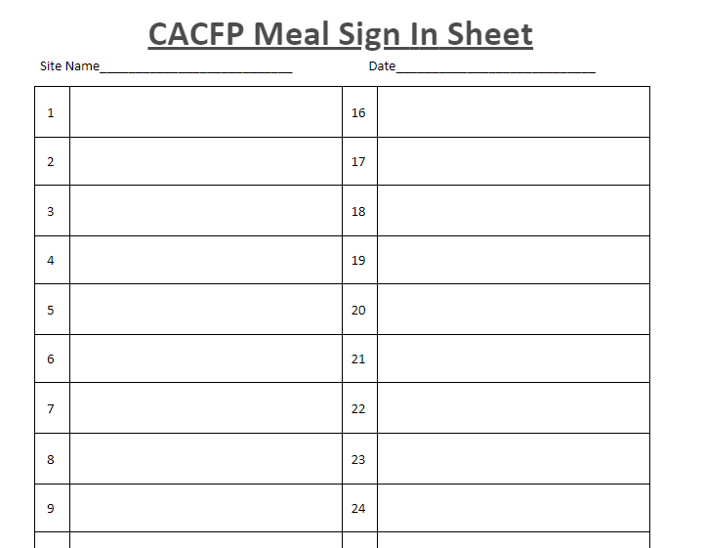
Notes:
Do this daily
Need to submit them once a week with the form FBA created and can be found on the landing page. Taking a picture with your phone and loading it up works the best
Can be a version of this too

Slide 12
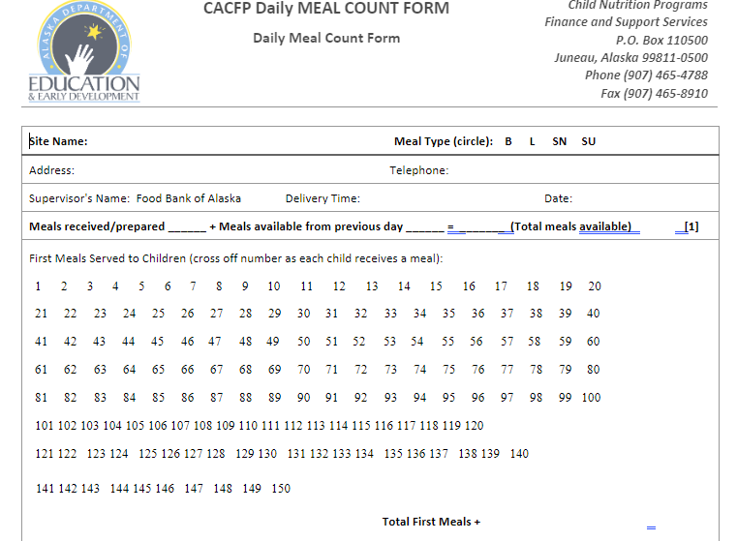
Notes:
Also must do this daily
Check off as the meal is handed out
Submit every week after Friday's service
Only claim first meals served to children
Document all program adult meals (cannot claim)
Meal Times
Follow the schedule date and times you submitted on the application
If any changes need to be made, please let FBA know ahead of time

Slide 13
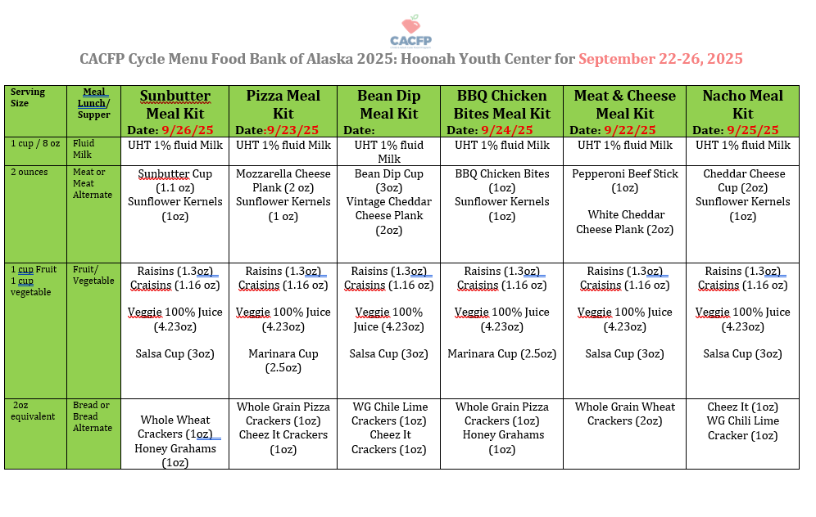

Slide 14
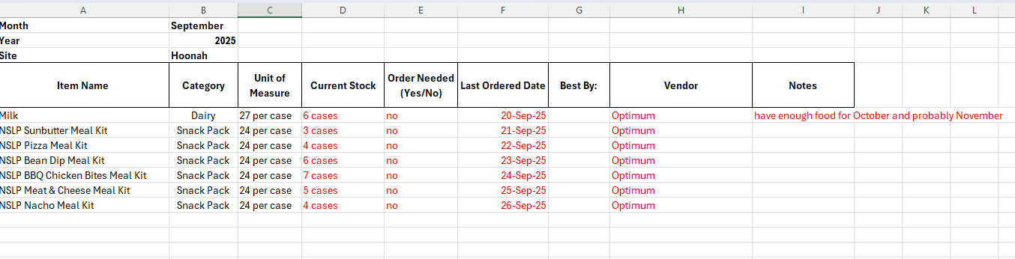
Monthly Inventory

Slide 15
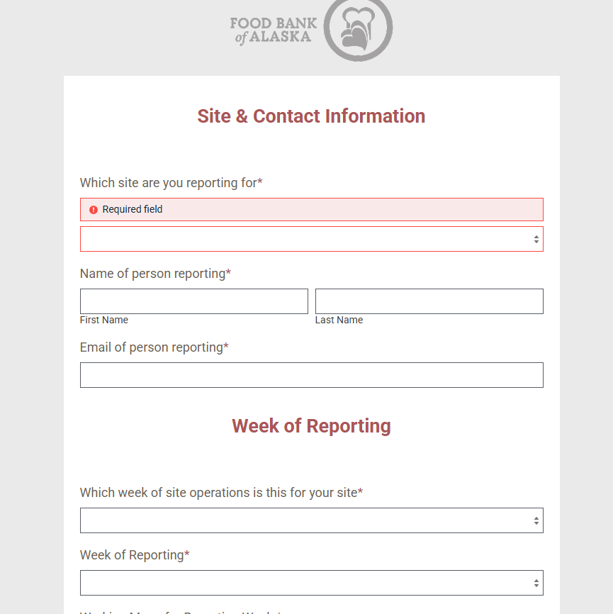
Online Submission Form

Slide 16

Why is my paperwork important?
FBA get reimbursed for every meal given to a child
Good documentation and timely reporting means FBA gets the $ needed to buy more meals and ship to your site
Reports done correctly and completed on time
=
More food coming your way!
Notes:
Site have chosen FBA as their sponsor to do the work of getting the food. We only get reimbursed for meals that have been handed out to kids and documented and handed back to us.
If FBA does not get the paper work in or even on time we can't buy and send more food thus no more CACFP for your site

Slide 17

Knowledge Check
How often do you submit your Meal Count and Attendance Sheets?
  Every Friday after service
What happens if the paperwork is not sent in on time and completed correctly?
  Makes it very difficult for FBA to get reimbursed for food and we will stop sending food to your site

Slide 18

Health Safety & Sanitation
Health Inspection
  DEC or Fire Inspection
Storage of meals
  6in off the floor
  6in away from wall
  In a dry secure area way from chemicals
Meal handling
  Prepackaged meals do not require gloves
  Wash hands before meal service
Sanitation
  Sanitize meal service tables and area
  Youth should wash hands before getting meals

Slide 19
USDA Nondiscrimination Statement
In accordance with federal civil rights law and U.S. Department of Agriculture (USDA) civil rights regulations and policies, this institution is prohibited from discriminating on the basis of race, color, national origin, sex (including gender identity and sexual orientation), disability, age, or reprisal or retaliation for prior civil rights activity.
Program information may be made available in languages other than English. Persons with disabilities who require alternative means of communication to obtain program information (e.g., Braille, large print, audiotape, American Sign Language), should contact the responsible state or local agency that administers the program or USDA’s TARGET Center at (202) 720-2600 (voice and TTY) or contact USDA through the Federal Relay Service at (800) 877-8339.
o file a program discrimination complaint, a Complainant should complete a Form AD-3027, USDA Program Discrimination Complaint Form which can be obtained online at: https://www.usda.gov/sites/default/files/documents/ad-3027.pdf, from any USDA office, by calling (866) 632-9992, or by writing a letter addressed to USDA. The letter must contain the complainant’s name, address, telephone number, and a written description of the alleged discriminatory action in sufficient detail to inform the Assistant Secretary for Civil Rights (ASCR) about the nature and date of an alleged civil rights violation. The completed AD- 3027 form or letter must be submitted to USDA by:
1. mail:
U.S. Department of Agriculture Office of the Assistant Secretary for Civil Rights 1400 Independence Avenue, SW Washington, D.C. 20250-9410; or
2. fax:
(833) 256-1665 or (202) 690-7442; or
3. email:
Program.Intake@usda.gov
This institution is an equal opportunity provider.
Notes:
Need to be displayed at site..green poster, sentence " This institution is an equal opportunity provider. USDA is in the process of updating the And Justice for All poster. For now you can use the poster example on the next slide.

Slide 20

And Justice for All Poster - Example
Notes:
Here is an example of the And Justice for All poster that needs to be displayed. If you do not have a current one please let us know.

Slide 21


Slide 22

Monitoring Requirements and Review Procedures
Monitoring must occur 3 times during the program year.
At least 1 review must include the Racial/Ethnic Data Report.
Monitoring must be conducted by someone unaffiliated with the site.
Stipend Position
Notes:
Monitoring vs Reviews
Monitoring:
Need to complete the form on the 1st, 4th and 12th week. Just making sure we are meeting all the requirements for the program to occur.
Monitor needs to be someone unaffiliated with the site
Form is available on the landing page or from the FBA
Please be honest
Having a Food Monitor lined up before you apply for CACFP is not required
Review:
At least two of these are to be unannounced visits
At least one unannounced review must include observation of meal service
At least one review must be during new facility's first four weeks of program operations-applies if break in operations
The amount of time between review may not exceed six months
Timing of reviews must be varied
Have a tracking system (Excel works well)
Will use same form as the Food Monitor

Slide 23
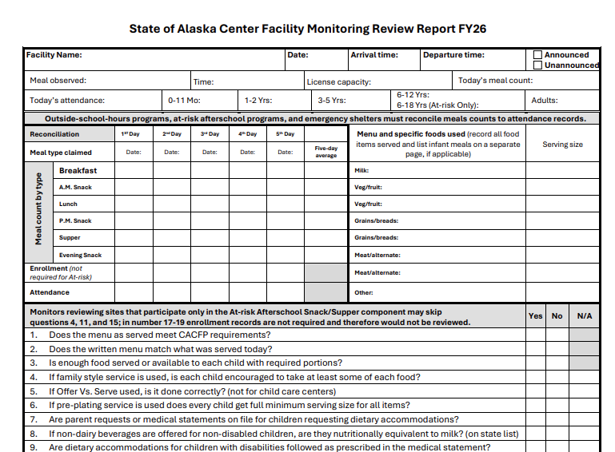
Notes:
Keep in if this is a training for Food Monitors
-don’t need to fill out the nutritional information at the top since the FBA has that all on file

Slide 24
FBA Reports to DEED
What does DEED care about?
What happens if there are deficiencies?
Notes:
DEED cares about the correct paper work being filled out and on time. Furthermore, following at the site requirements and meal protocols
What happens if there are deficiencies?
If non-compliances are found during monitoring:
Corrective Action required with deadline- need to be met and hopefully issue is corrected premenatly
If corrective action deadline is not met, finding no permenant corrected, or serious issues found:
Program may be deemed seriously deficient
If found to be seriously deficient: State agency may do follow-up review
Termination of program and principals added to the National Disqualified List (NDL)
On the list for at least 7 years ie: can't run the program for 7 years

Slide 25
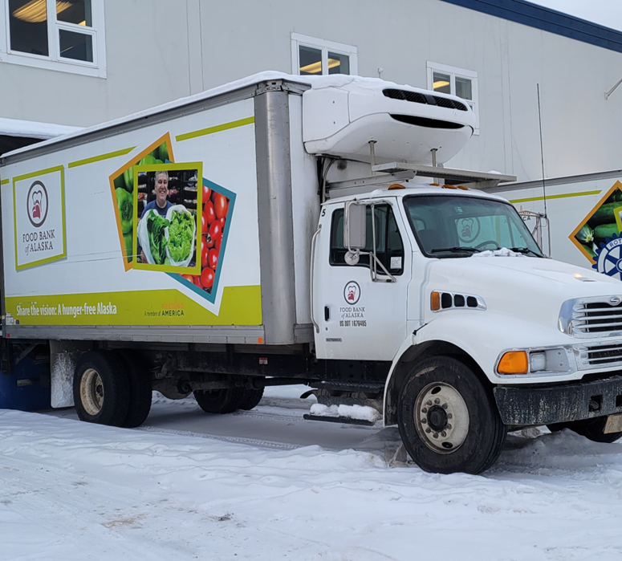

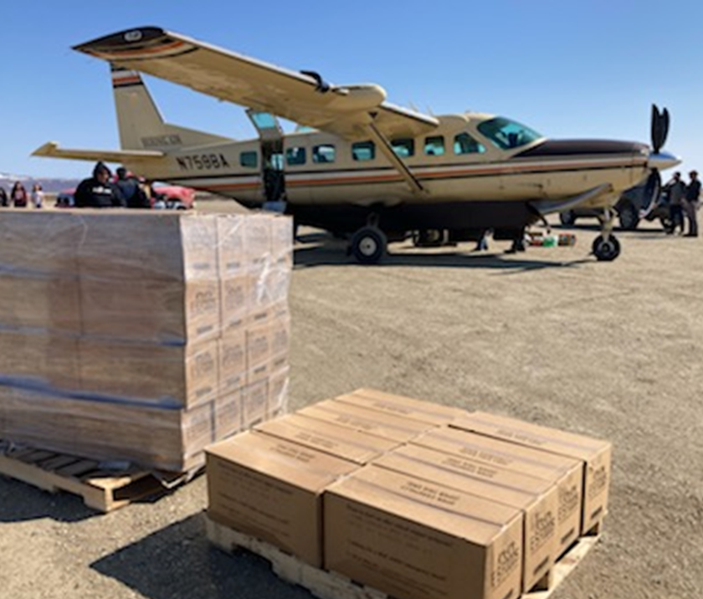

Meal Delivery and Ordering Requirements
Bypass Sites will receive 1,100lbs orders
Sites must put in meal requests to a member of the child nutrition team at the FBA
Timeline from request:
1-3 Days: Order put into warehousing ordering system
8-10 Days: FBA Warehouse Team picks order and delivers to shipping company
11-24 Days: Meals with shipping company in transit
Notes:
Bypass sites will receive 1,100 pound orders in their shipments unless otherwise coordinated

Slide 26

Questions??

Slide 27

Thank you and any questions please reach out!
Enrique Ramirez
Child Nutrition Program Coordinator
eramirez@foodbankofalaska.org
(907)-222-3115
Janee Wilson
Children Nutrition Program Coordinator
jwilson@foodbankofalaska.org
(907)-222-3107
Gillian McPherson
Child Nutrition Manager
gmcpherson@foodbankofalaska.org
(907)-222-3105

